Slide 1
Python Basics
Let’s get into the first class!

Slide 2
CONTENTS
This is a the main contents of today’s class.
We will learn the following during today’s class.
Using visual studio code | Install visual stduio code and print "Hello, World!".
Data Types and Variables | Learn Variables, Data Types, Rules of variables names.
Comments | Learn comments, explanation for readers.
Input | Learn how to get user-entered data
Operators | Learn four arithmetic operations, logical operators, and comparison.
List | Learn List(1-dimensional and 2-dimensional list), indexing, and list comprehension.
Functions | Learn basic concept of function and how to call function.

Slide 3
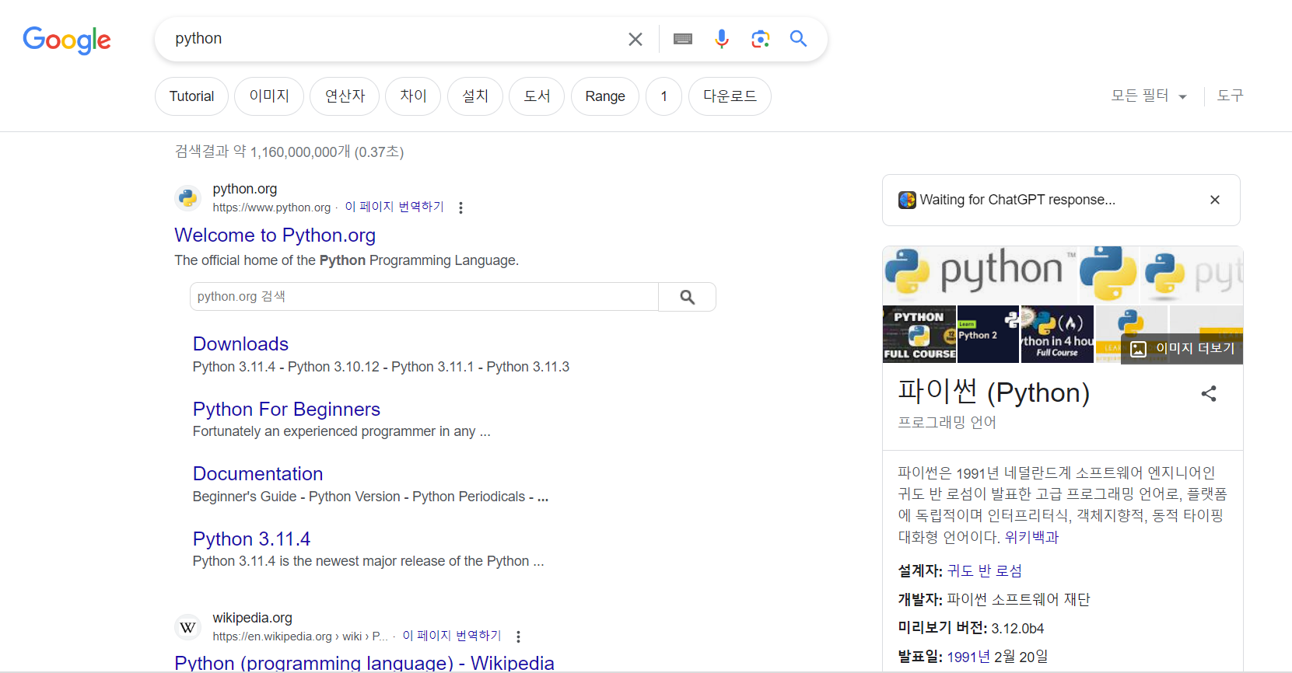

Slide 4
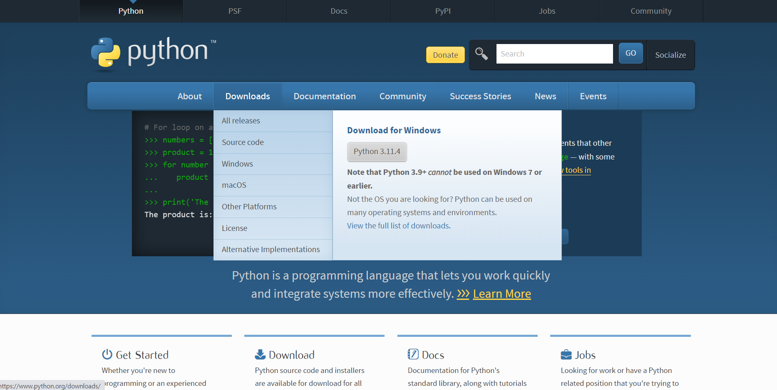

Slide 5
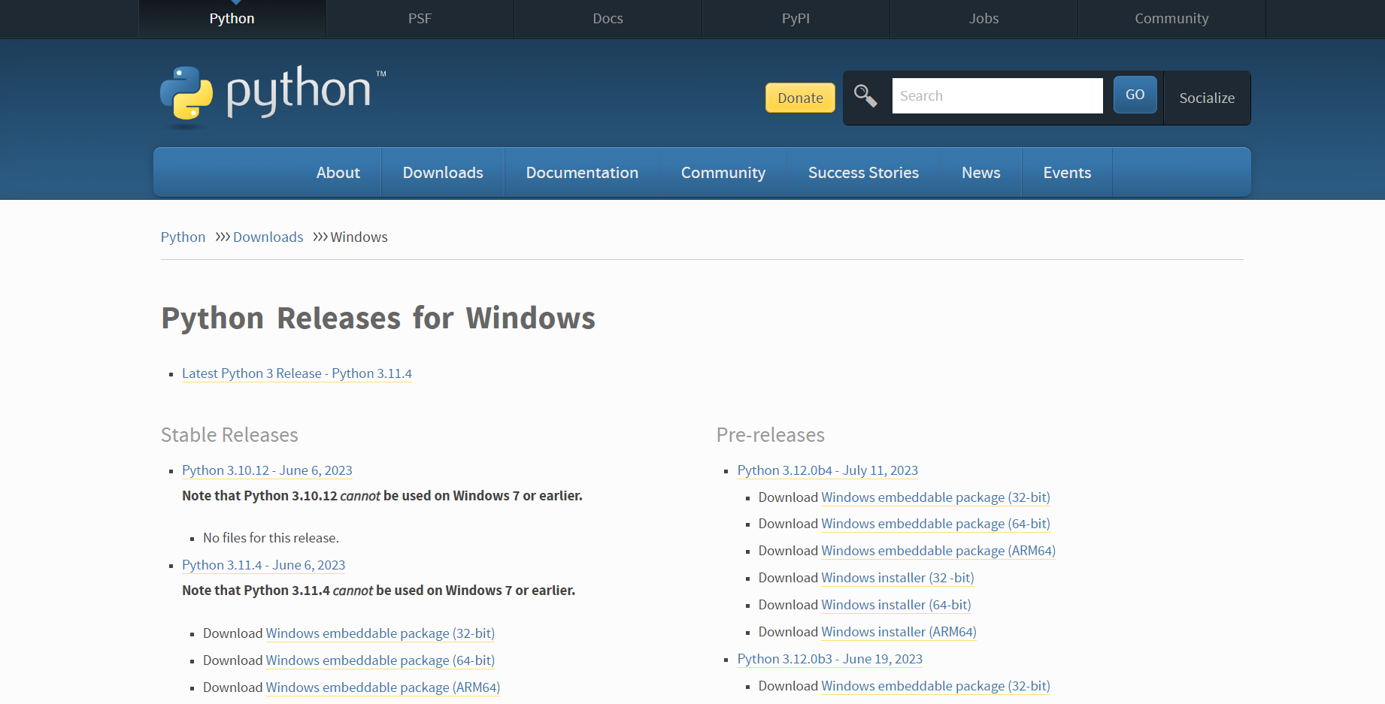

Slide 6
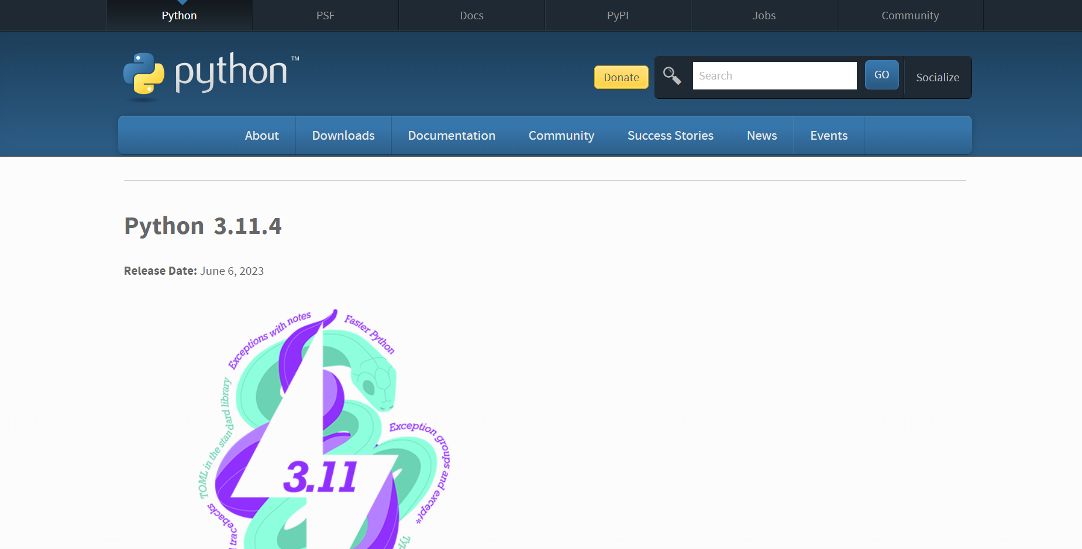

Slide 7
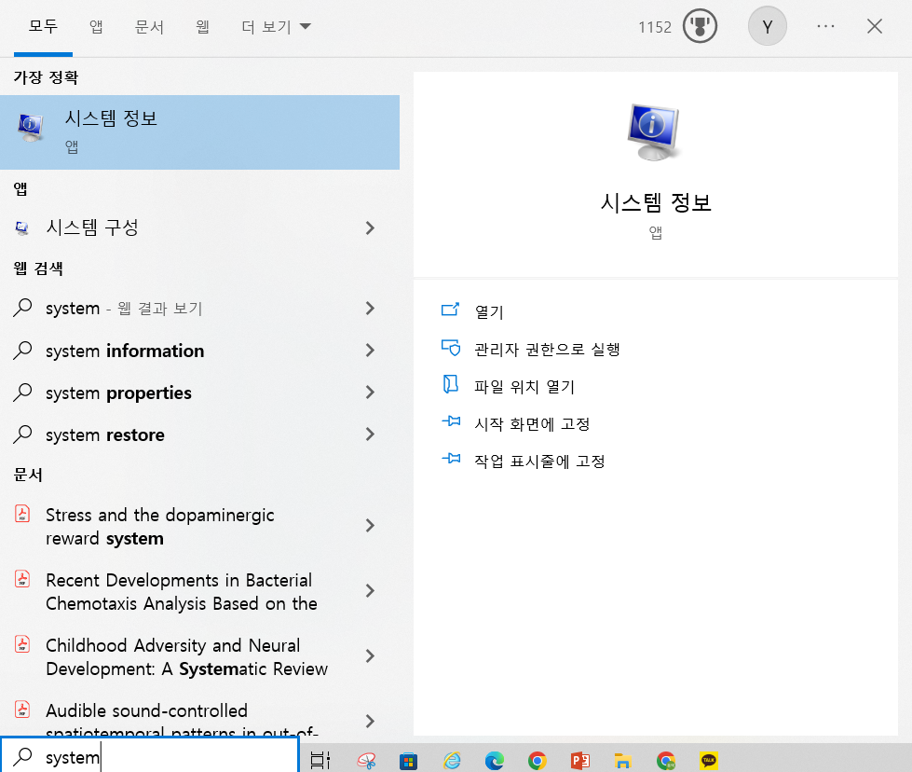
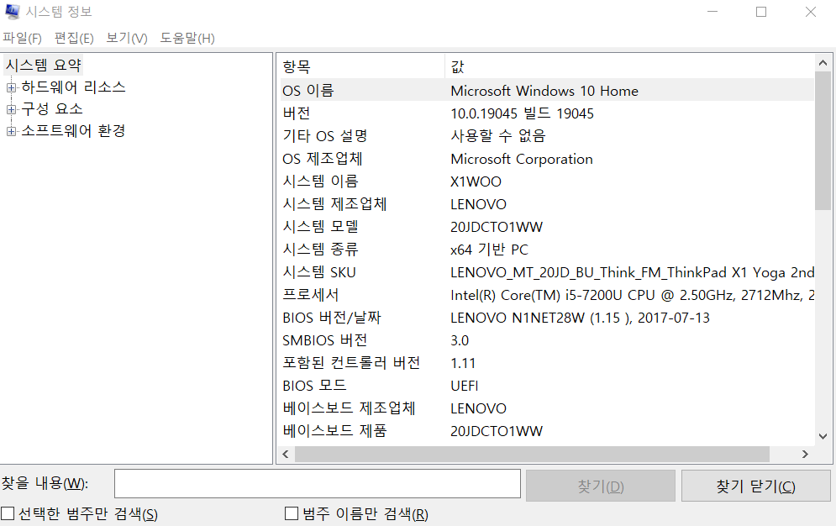

Slide 8
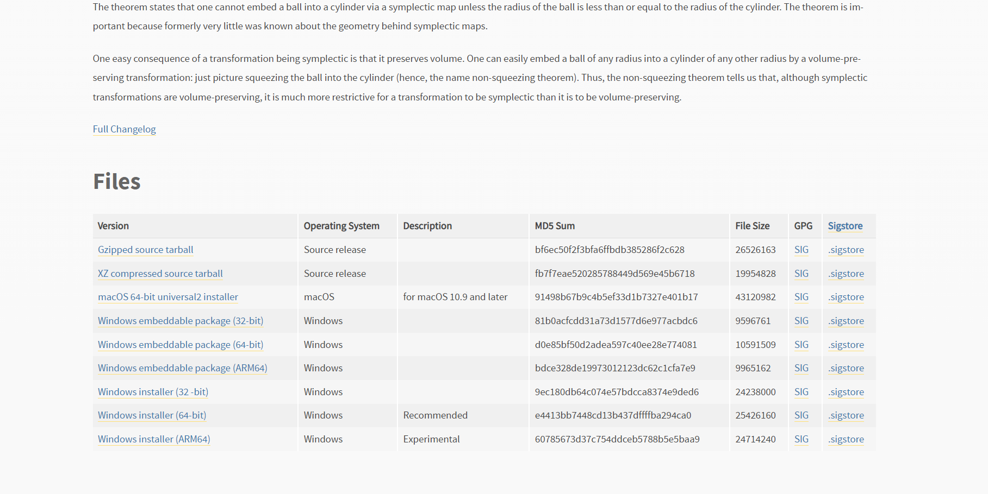

Slide 9
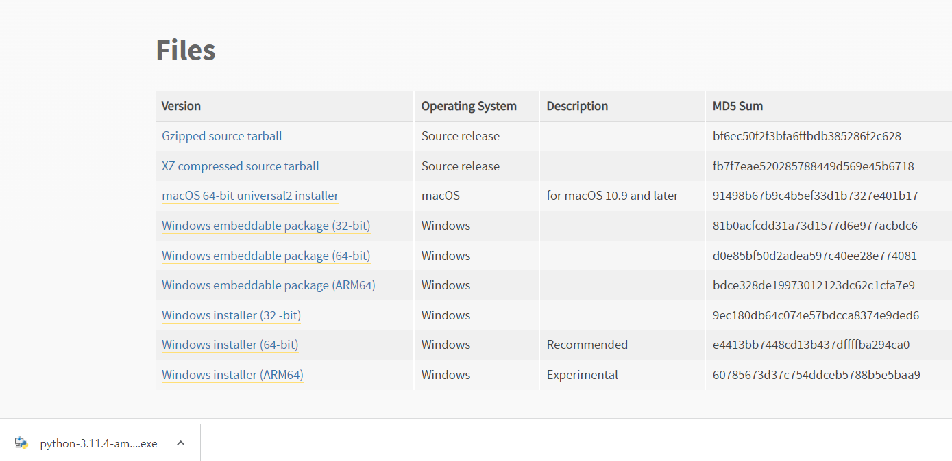

Slide 10
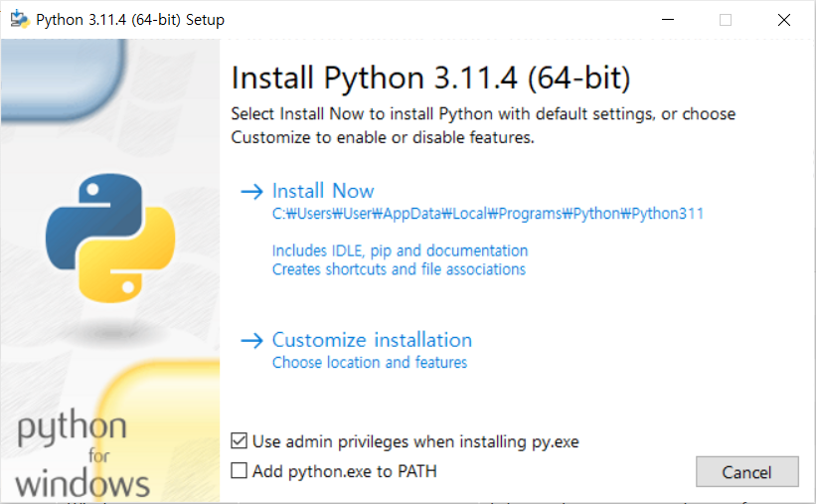

Slide 11
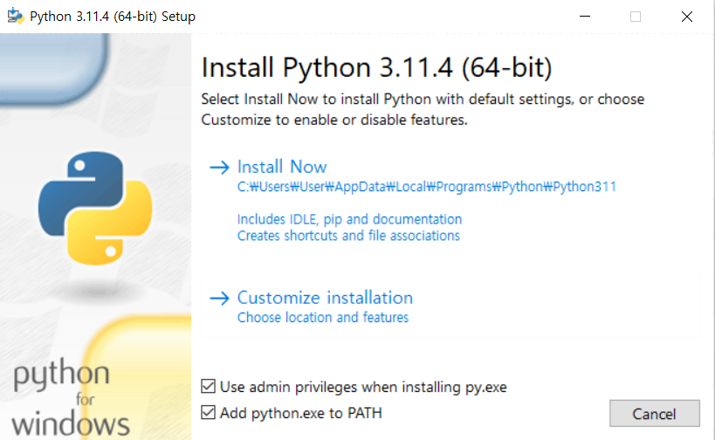

Slide 12
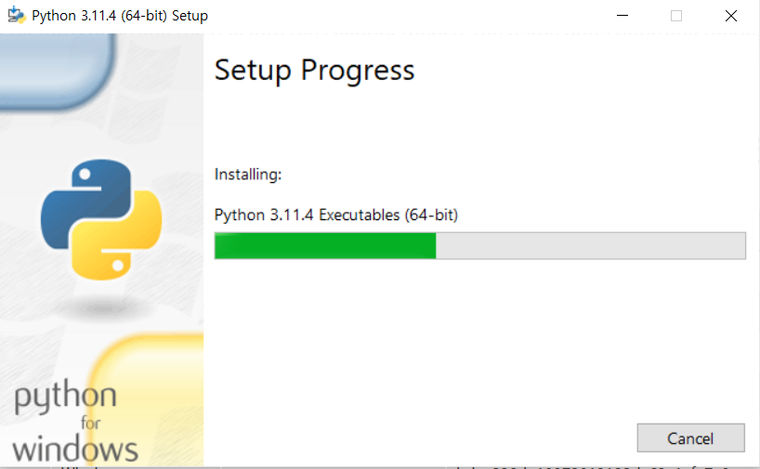

Slide 13
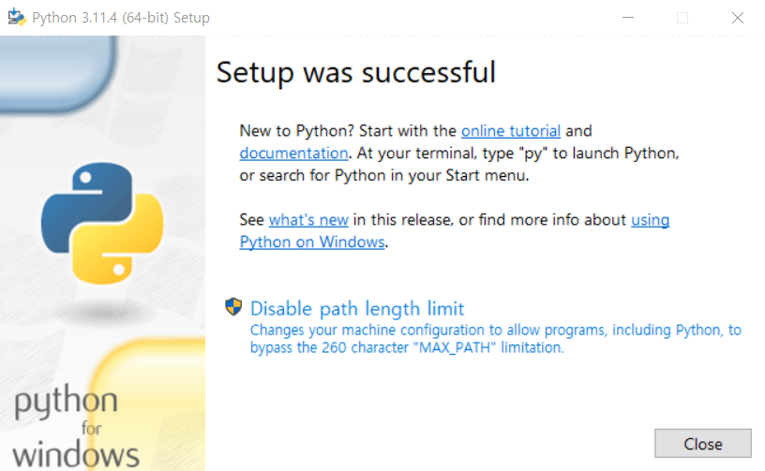

Slide 14
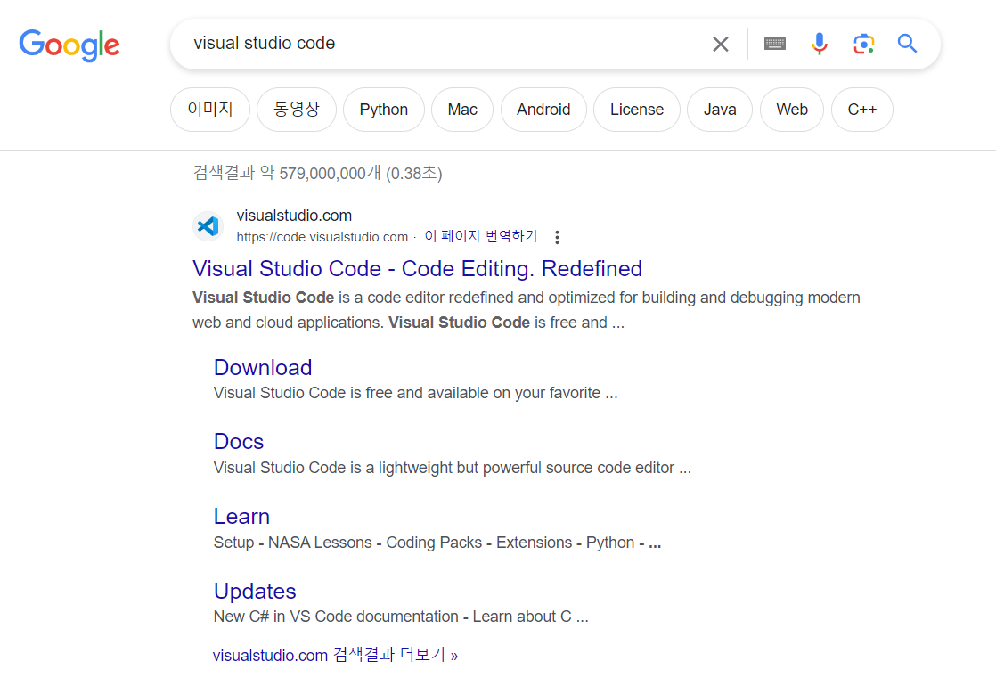

Slide 15
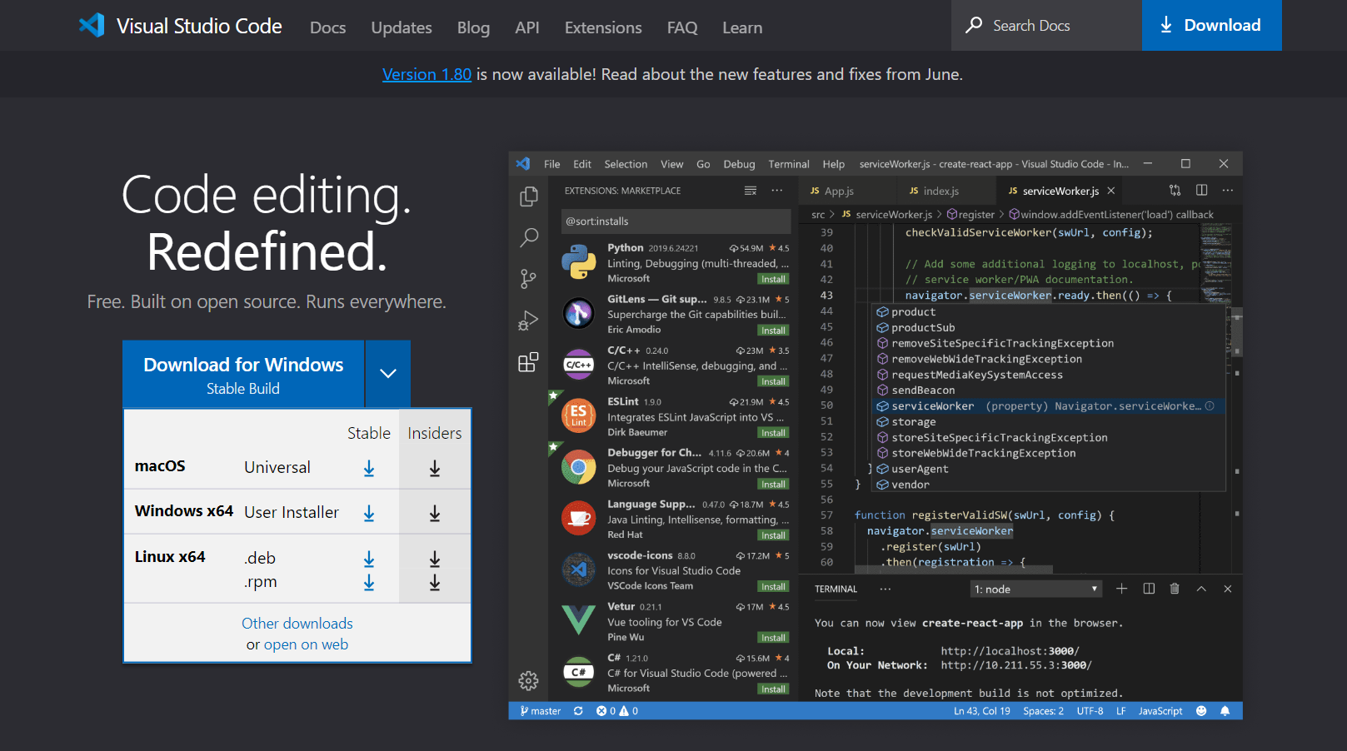

Slide 16
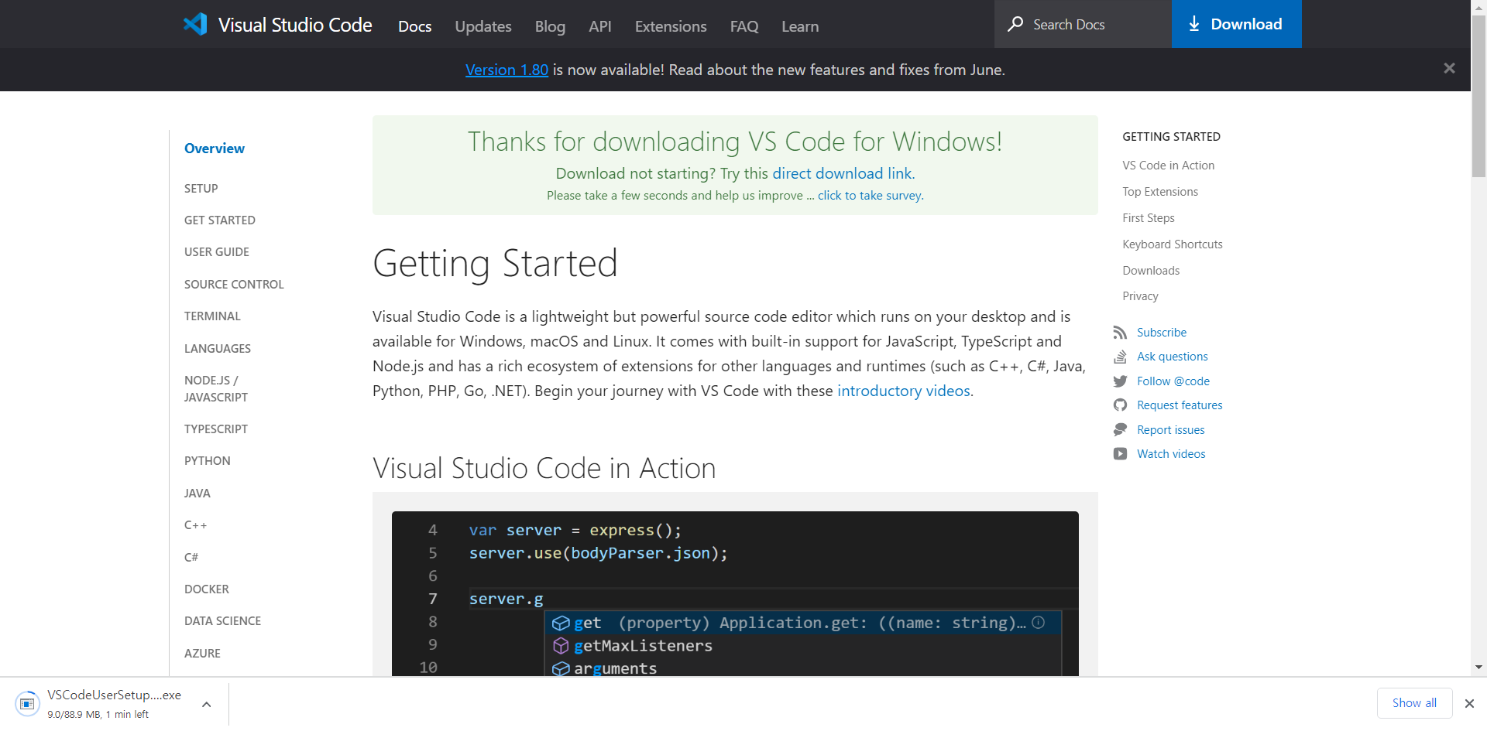

Slide 17
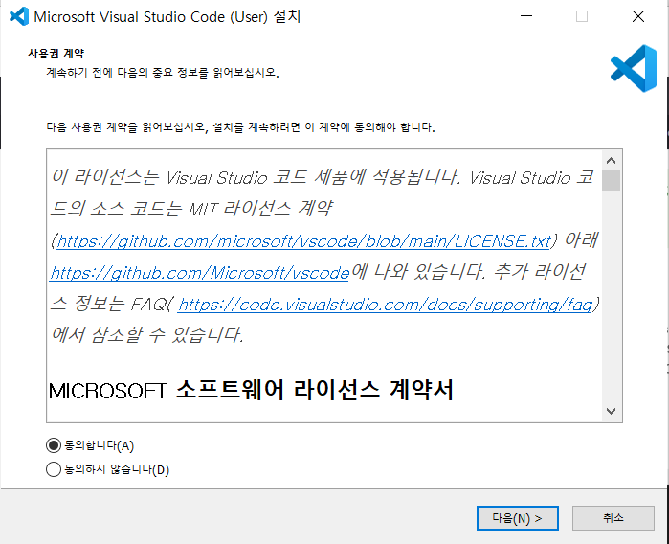

Slide 18
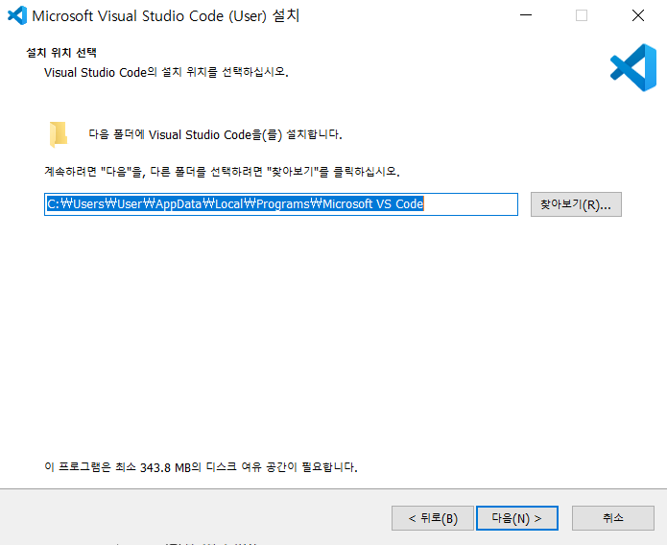

Slide 19
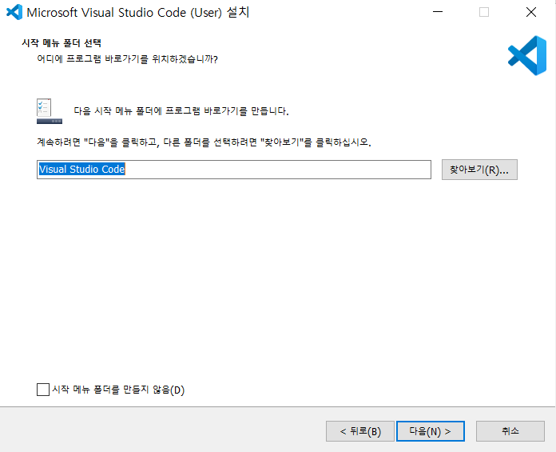

Slide 20
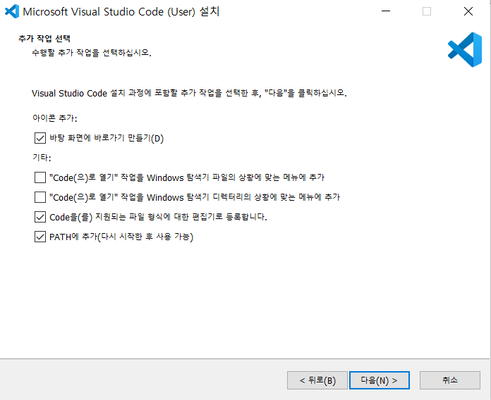

Slide 21
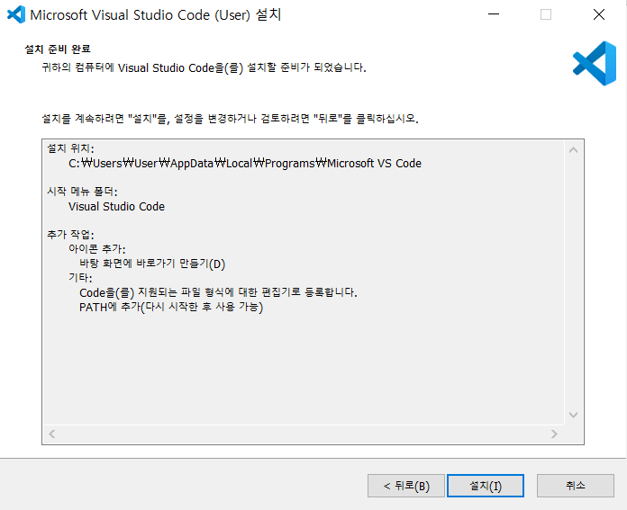

Slide 22
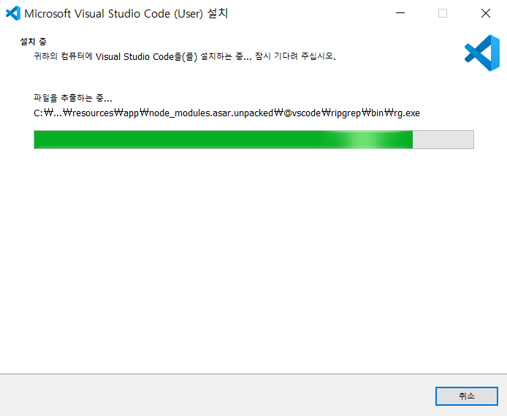

Slide 23
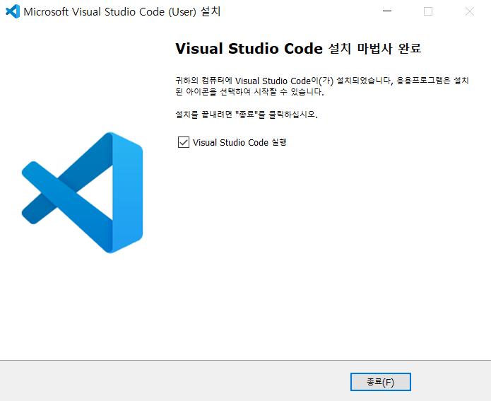

Slide 24
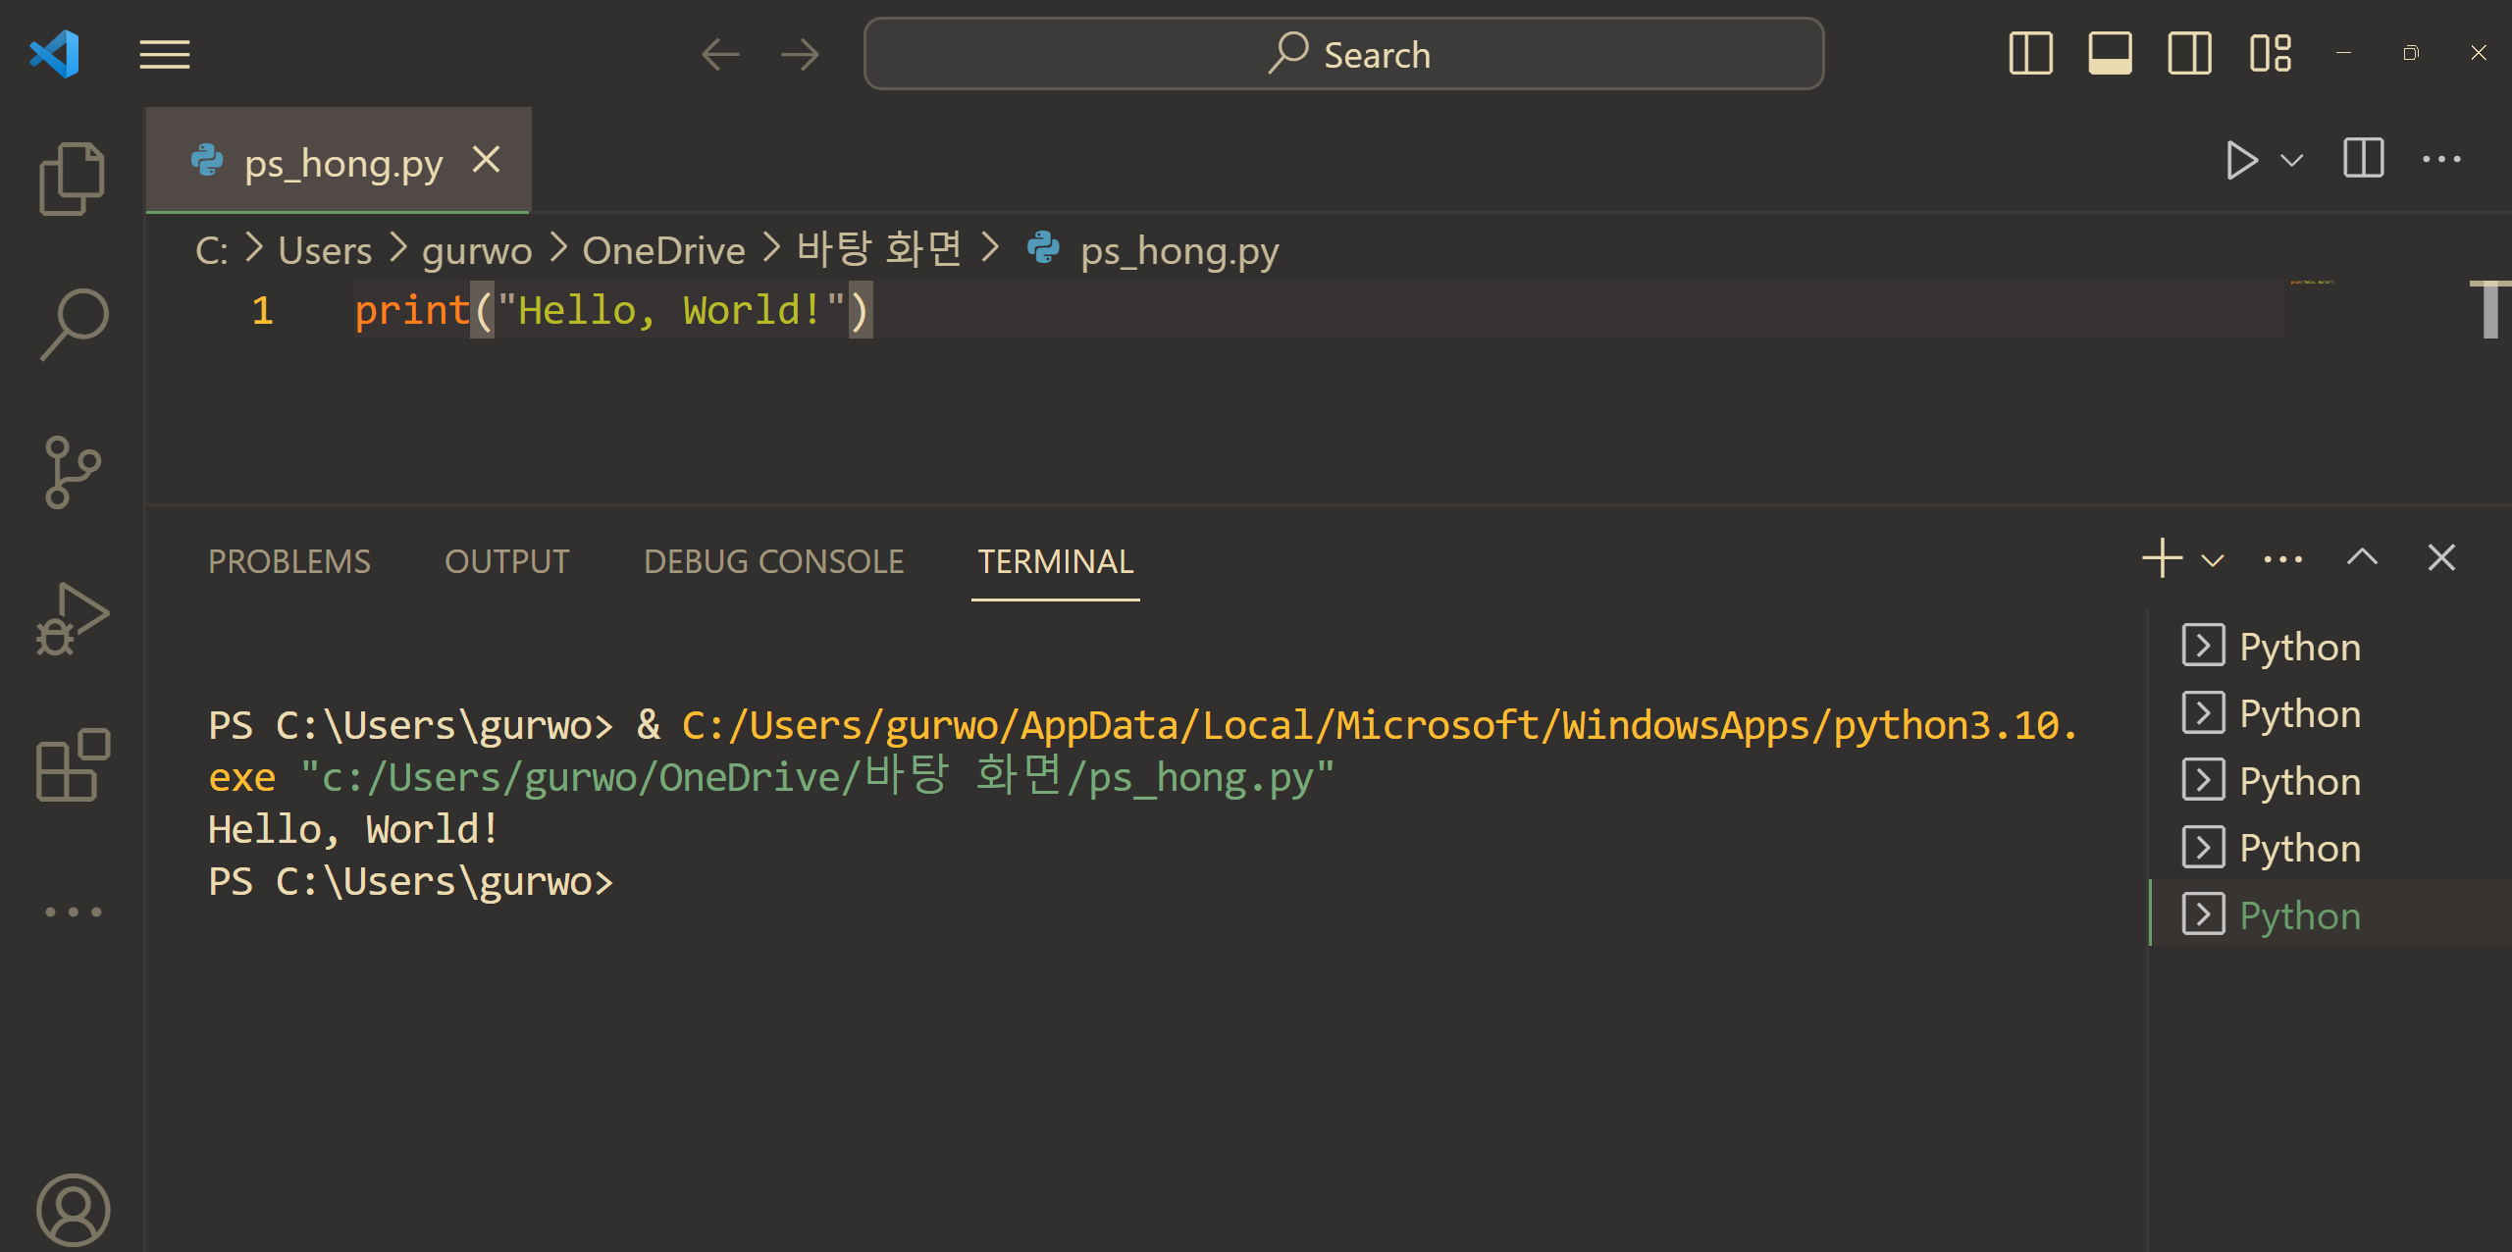
USING visual studio code
Let's print "Hello, World!" in vscode(visual studio code)
2. click
1
3. "Hello, World!" is printed

Slide 25
Lab
Now, try printing your name!

Slide 26
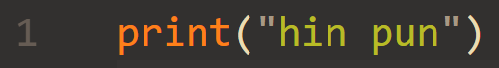
Answer

Slide 27
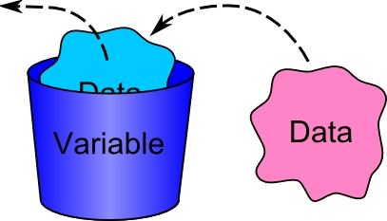
Data Types and Variables
Variables are baskets where you can store different types of data.
name_of_variable = data

Slide 28


Data Types and Variables
For example, if you execute this code, then ….
hin_pun = 19
if you write 'hin_pun', computer will result in 19. For example, if you write print(hin_pun) …
hin_pun
19
let me know hin_pun !!!
19 !!!
print(hin_pun)
hin_pun
19
computer:
hin_pun is … 19 !!!
computer
user

Slide 29
Data Types and Variables
However, there are some rules of declaring variables(labeling to the baskets):
Numbers are not allowed for the first part of the variable name.
Only alphabets and numbers, underscores(_) are allowed.
Blanks are not allowed in variable name.
Predefined keywords in python, such as commands and are not allowed.
a = 10 | stores 10 in a
1hong = 0 | error !!
b = 'hong' | stores 'hong' in b
_k = 100 | stores 100 in _k
k k = 10 | error !!
k% = 10 | error !!
print = 10 | error !!

Slide 30
Data Types and Variables
Predefined keywords in python, such as commands and are not allowed.
value keywords | True, False, None
operator keywords | and, or, not, nor, is, in
control flow keywords | if, elif, else
structure keywords | def, class, with, as, pass, lambda
import keywords | import, from, as
exception-handling keywords | try, except, raise, finally, else, assert
other keywords | return, del, global, __init__, __repr__

Slide 31

Lab
Guess if each code will result in an error
hong = 10
print = 1
_hong = 10
11jae = 10
lala@ = 10
he he = 10
HINT
Remember rules of variable name.

Slide 32
Answer
hong = 10 O
print = 1 X
_hong = 10 O
11jae = 10 X
lala@ = 10 X
he he = 10 X

Slide 33
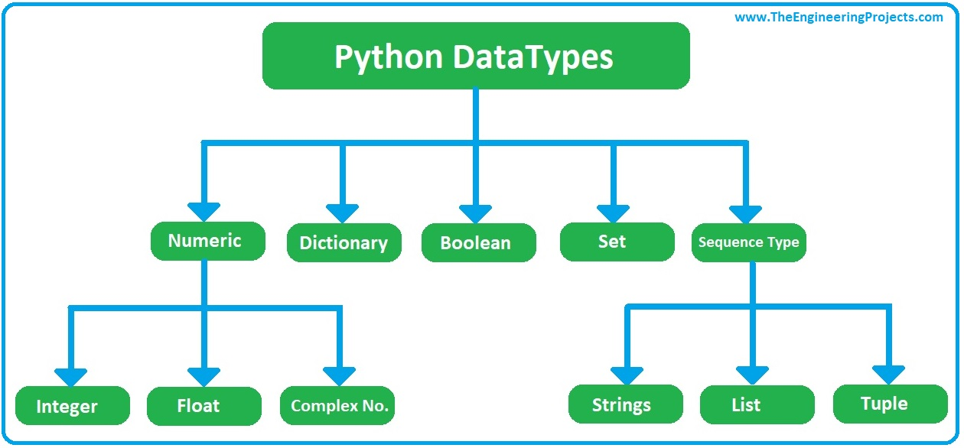
Data Types and Variables
There are different data types such as int(integer), float, str(string), bool(boolean)
“int” type stores integers such as 1, 2, 3, 4, -1, -2 ….
“float” type stores floating point numbers such as 2.1, 3.4, 6.589
“str” type stores strings(text) such as words, sentences, …
“bool” types stores Boolean data types(True or False)
To know which data type something is, use type() function; type(name_of_variable)

Slide 34

Data Types and Variables
If you want to store your information, you need to store different data types, because name, school, and occupation are string type, weight is float type, height is int type, and so on.
Name: hin pun => string
height(cm) : 168 => integer
weight(kg) : 53.5 => float
language : Korean => string
school : GIST => string
occupation : student => string
blood type : A => string
is he married? : False => bool

Slide 35
Data Types and Variables
Name = 'hin_pun' | stores string
height = 168 | stores integer
weight = 53.5 | stores float
language = "Korean" | stores string
school = 'GIST' | stores string
occupation = 'student' | stores string
blood_type = 'A' | stores string
is_he_married = False | stores Boolean
print(type(name)) | prints the data type of variable 'name'

Slide 36
Lab
After storing these information in variables, print data types of the variables.
Name: hin pun => string
height(cm) : 168 => integer
weight(kg) : 53.5 => float
language : Korean => string
school : GIST => string
occupation : student => string
blood type : A => string
is he married? : False => bool
HINT
use type() function !!!

Slide 37
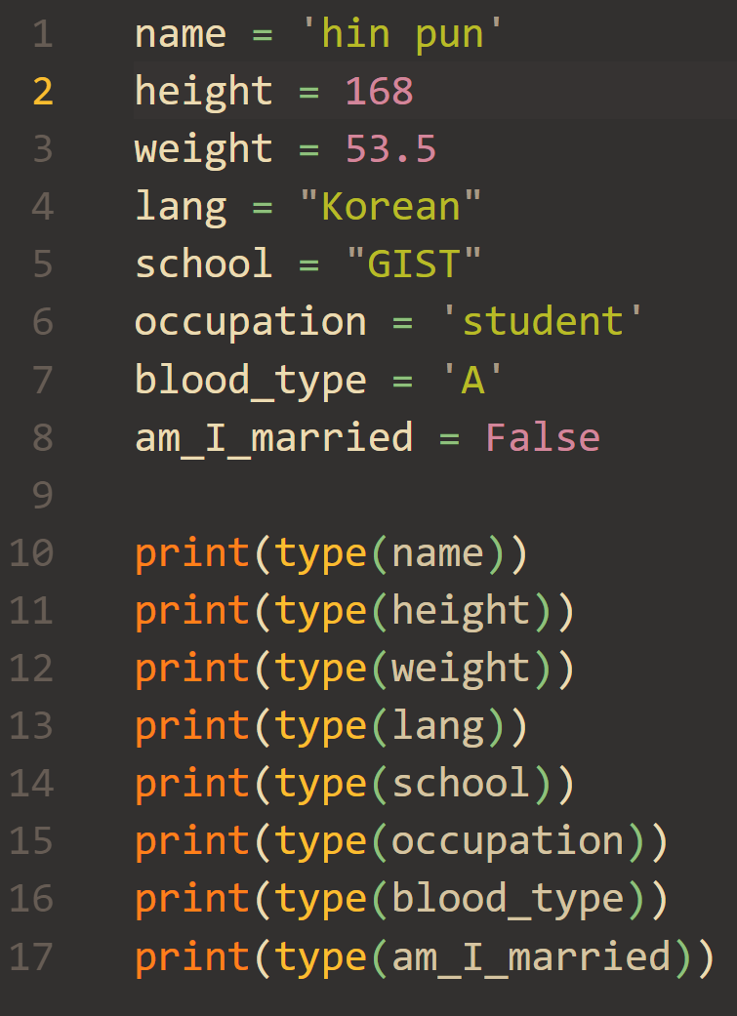
Answer

Slide 38
Lab
Make a variable that stores your height and print the data of the variable in this format:
Format: My height is 165.5.
HINT
name_of_variable = data

Slide 39
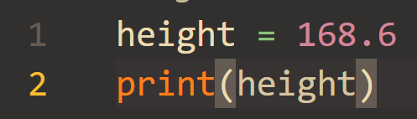
Answer

Slide 40
Lab
make 2 variables that store your age and name, respectively. And print the data of the variables.
HINT
19 is integer and hin pun is string. To declare string, you need write with quotation marks: name = 'hin pun' or name = "hin pun"

Slide 41
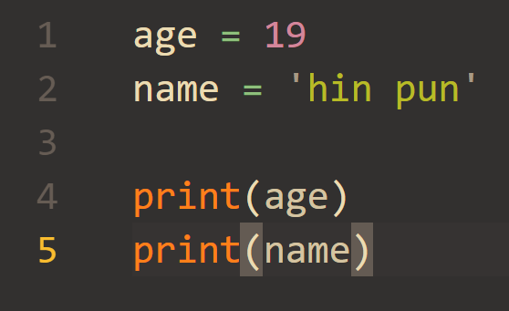
Answer

Slide 42
Data Types and Variables
Try to execute the following!
type(True) type(4.9) | Prints: type<“bool”> Prints: type<“float”>
c=False d=3.14 print(c, d) | Stores False in a(a becomes bool type) Stores 3.14 in b(b becomes float type) Prints: False 3.14

Slide 43
Comments
In programming, you can write brief explanations of codes. They are called "comments". You can write comments by starting with '#'.
#write anything here…. this line is not executed
As I said, comments are just explanations of codes. Therefore, they are not executed.
# though you write anything in this line # computer does not execute them. | starting with '#', they are comments and are not executed.

Slide 44
Output
This is how to print sentences
The print() function prints the value or data
This function prints the input data in order, with blank spaces to divide each others
print(“Hello, World”) print(1, 2, 3) | This line is to print “Hello, World” This line prints 1 2 3 in order with blank spaces between.

Slide 45
Lab
print a triangle:
*
**
***
****
*****
HINT
use print() !!!

Slide 46
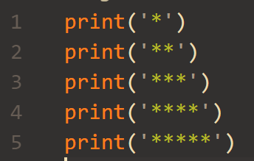
Answer

Slide 47


Input
In café, staffs get your order. In this example, a staff is a computer, and a customer is a user.
Can I get your order?
Oh, yeah. One cappuccino plz.
It's 30,000 LAK
a staff
a customer

Slide 48
Input
Here, data( one cappuccino ) in the red box is user-entered data.
Can I get your order?
Oh, yeah. One cappuccino plz.
user-entered data
It's 30,000 LAK
a staff
a customer

Slide 49
Input
To receive user-entered data, we use input() function.
input() function always stores string data type.
order = input() | receives user-entered data and stores it in variable 'order' as string data type.
print(type(order)) | data type is always 'string'

Slide 50
Input
Also, you can add a question.
order = input('Can I get your order? : ') | receives user-entered data and stores it in variable 'order' as string data type.
print(type(order)) | data type is always 'string'

Slide 51
Lab
After writing this code, try inputting 10, 3.14, Cappuccino, and True.
Before executing them, guess the results.
var1 = input('input : ') print(type(var1))
HINT
remind that input() always receives string type. Then what would the results be?

Slide 52
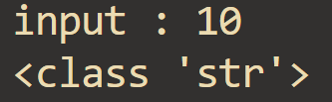
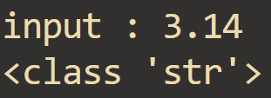
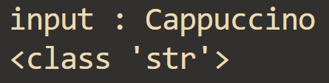
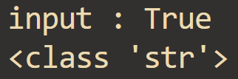
Answer
Because input() always receives string type, the results are always <class: 'str'>, which means string type, though you wrote integer, float, and bool type.

Slide 53
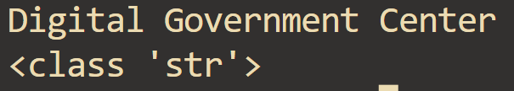
Lab
Make a program that receives the name of this organization from a user, and prints it and the data type of it.
input
output
HINT
1.use input() !!!
2.To know data type of variables, use type() !!!

Slide 54
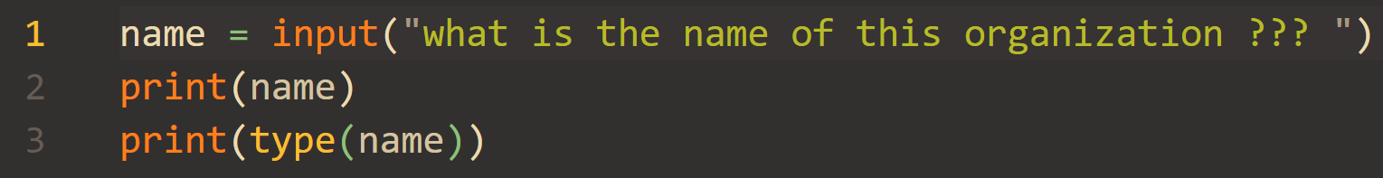
Answer

Slide 55
Input
However, your age, height, and weight are not strings. They are numerical data. Therefore, you need to change the data types from strings to numerical data such as int or float. To do so, we use int() and float().
b=int(input()) print(type(b)) | receives user data. However, what is different from before is that the data type of variable b is 'int' which is integer because of int().
c = float(input()) print(type(c)) | receives user data as float type because of float().

Slide 56
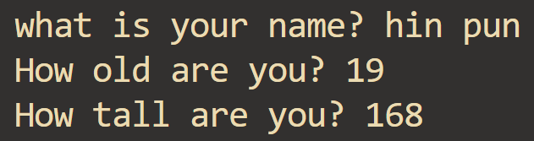
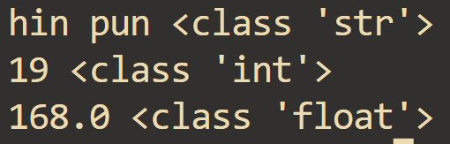
Lab
Make a program that receives your name, age, and height, prints them and their data type. name is string type, age is int type, and height is float type.
input
output
HINT
1.To convert string to int, use int()
2.To convert string to float, use float()

Slide 57
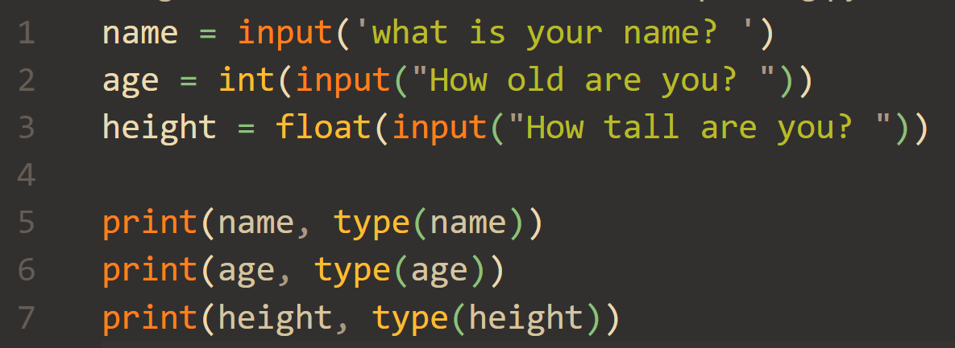
Answer

Slide 58
Operators
Python can calculate basic operators.
print(2+5) print(2*5) print(2-5) print(2/5)
print(32//5) print(32%5) | Floor division. The result is the quotient Remainder operation.

Slide 59
Operators
Quotient operator is '//' and remainder operator is '%'.
32 = 5 x 6 + 2
print(32//5) print(32%5) | Floor division. The result is the quotient Remainder operation.

Slide 60
Operators
Try executing the following.
b=input() print(b*2) | Input value: 3 Prints the string twice.
b=int(input()) print(b*2) | Input value: 3 Prints 3 multiplied by 2.

Slide 61
Operators
To receive int type, use int(input()). If you use input(), str type is received.
Try executing the following.
b=input() print(b+'water') | Input value: a glass of Prints 'a glass of water'
b=int(input()) print(b+2) | Input value: 3 Prints 3 plus 2

Slide 62
Operators
Logical operators are widely used in computers.
The “or” operator results TRUE if 1 or more input data is TRUE.
The “and” operator results TRUE only if all of the input data is TRUE.
The “not” operator results in the exact opposite(TRUE or FALSE) of the whole data.
Nonzero values such as 1, 100 means TRUE in logical operations.
Zero(0) means FALSE in logical operations.
x₁ | x₂ | y(x₁ or x₂)
1 | 1 | 1
1 | 0 | 1
0 | 1 | 1
0 | 0 | 0
x₁ | x₂ | y(x₁ and x₂)
1 | 1 | 1
1 | 0 | 0
0 | 1 | 0
0 | 0 | 0
x | not x
1 | 0
0 | 1

Slide 63
Operators
You can also compare two variables with comparison operators.
a == b | Are a and b the same?
a > b | Is a bigger than b?
a < b | Is a lower than b?
a >= b | Is a bigger than or equal to b?
a <= b | Is a lower than or equal to b?
a != b | Are a and b different?
NOTIFICATION
'=' and '==' are different. '=' is used to make variables. It means storing data on the right side in variable on the left side. '==' means 'equals to'.

Slide 64

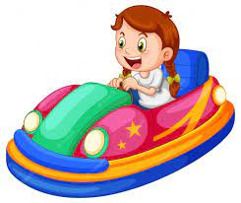

Conditions
If a child whose height is 108 cm wants to use a bumper car whose restriction is that "height must be bigger than 120", staffs says he can't use it. Of course, if he is taller than 120 cm, then he can use it.
your height is ???
It's 108 cm !!!
Oh, sorry… You can't use it …
restriction:
height > 120

Slide 65
Conditions
If we implement it, the program flow would be like …
get child's height:
Your height is ???
Sorry … You can't use it …
Is he taller than 120 cm?
This is called condition:
height > 120
No
Yes
Enjoy !!!

Slide 66
Conditions
We can use the if, else statement to implement it. When using the if else statement, the line including the condition should have colon(:) at the end. Also, the execution block should be indented with the same extent. To indent, press 'Tab'.
Conditions are like a>10, a<=b, (a and b) or (c or d) ….
If the condition is True, then if_block is executed. If condition is not True, which is False, else_block is executed.
if condition:
if_block
if condition:
if_ block
else:
else_block
Tab

Slide 67
Conditions
a=10 if(a==10): print(“a is equal to 10”) else: print(“a is not equal to 10”) | Executes the following indented block if a is equal to 2 Indented block. Prints “a is equal to 10” Executes the following indented block if the above condition is false. Indented block. Prints “a is not equal to 10”
b = 'hong' if b == 'hong': print('Nice to meet you, hong!!')

Slide 68
Lab
Let's go back to our example shown at the first slide of the subject 'Conditions'.
If a child whose height is 108 cm wants to use a bumper car whose restriction is that "height must be bigger than 120", staffs says he can't use it. If he is taller than 120 cm, then he can use it. Make a program that receives height (float type), and prints "Enjoy!!" if height is bigger than 120.00 and "Sorry… you can't use it…" if height is not bigger than 120.00.
your height is ???
It's 108 cm !!!
Oh, sorry… You can't use it …
restriction:
height > 120
HINT
receives height from users: use input()
height = float(input('your height is ???'))
use if else statement

Slide 69
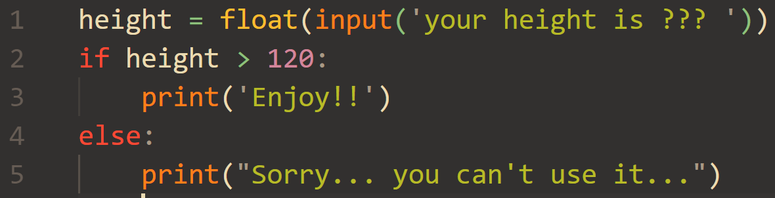
Answer

Slide 70
Lab
Now, try to make a program that allows only people with age 20 to 35 to enter.
Ex) input: 23
Output: You can enter
Input: 39
Output: You cannot enter

Slide 71
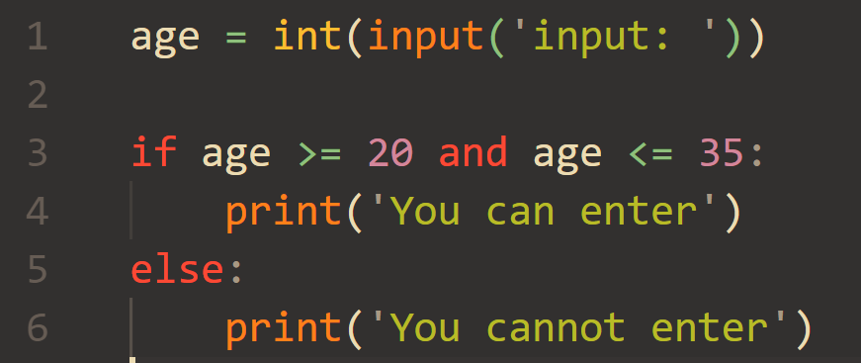
Answer

Slide 72

Iteration(while)
We can also make programs repeat things in certain conditions.
We can use the while statement. When using the while statement, the line including the condition should have colon(:) at the end. Also, the execution block should be indented with the same extent.
You are younger than 20 years old !!! Go to your room and STUDY !!!!!!

Slide 73
Iteration(while)
STRUCTURE
while condition:
execution
while age < 20:
print("Go to your room and STUDY !!!!")
condition
You are younger than 20 years old !!!
Go to your room and STUDY !!!!!!
execution

Slide 74
Iteration(while)
a=10 while(a<10): print(“value of a is ”, a) a=a+1 | Repeats the following indented block if a is smaller than 2 Indented block. Prints “value of a is ” and the value of a Store value of a+1 in a.(same as a+=1)
b = 7 while b < 8: print("hin pun") | This will print 'hin pun' infinitely because the condition is always True ( b is 7 and doesn't change. Thus, b < 8 is always True ).

Slide 75
Iteration(for)
“for” is a convenient way of repetition. It repeats the indented block with some rule.
STRUCTURE
for variable in range(start, end, step):
execution
=> from start to end – 1 by step

Slide 76
Iteration(for)
The following two codes do the same thing.
a=0 while(a<10): print(“value of a is ”, a) a=a+1 | Repeats the following indented block if a is smaller than 2 Indented block. Prints “value of a is ” and the value of a Store value of a+1 in a.(same as a+=1)
for a in range(0, 10, 1): print(“value of a is ”, a) | Initial value of a is 0. while a<10. increment a by 1 Indented block. Prints “value of a is ” and the value of a

Slide 77
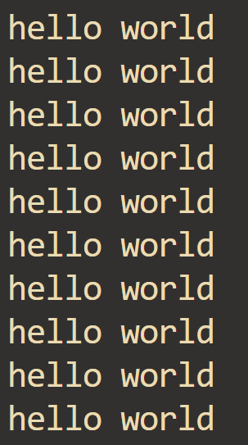
Lab
Make a program that prints 'hello world' ten times. make two versions using while and for, respectively.

Slide 78
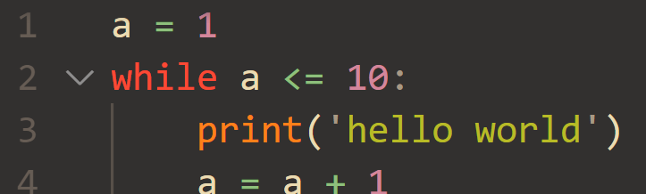
Answer

Slide 79
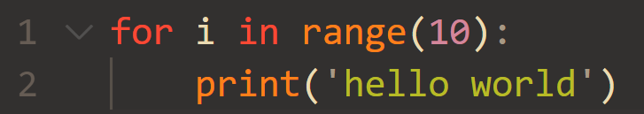
Answer

Slide 80
Lab
Now, try to make a program that prints the multiplication of the input number.( try to make two programs using while and for, respectivcely )
Ex) input: 2
Output: 2X1=2
2X2=4
2X3=6 …

Slide 81
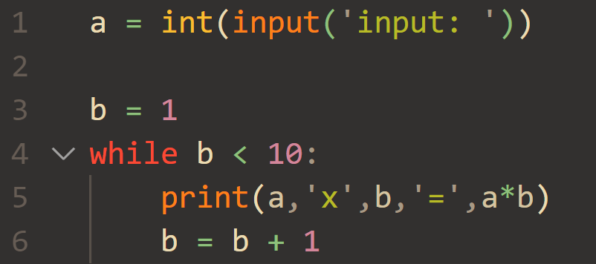
Answer

Slide 82
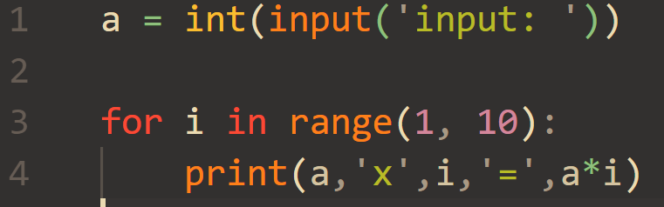
Answer

Slide 83
Lab
Now, try to make a program that prints if the input number is a prime number! Make two versions using while and for.
Ex) input: 7
output: This is a prime number
HINT
Prime number is a number that has two divisors.
ex) 3 is 1 x 3, 5 is 1 x 5, 11 is 1 x 11

Slide 84
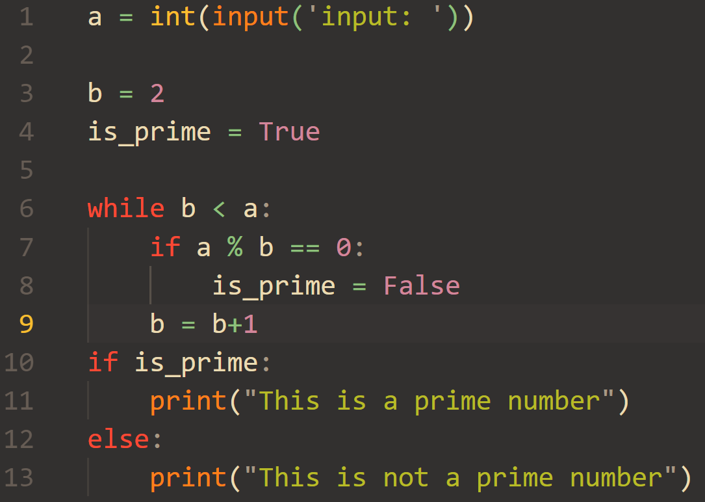
Answer

Slide 85
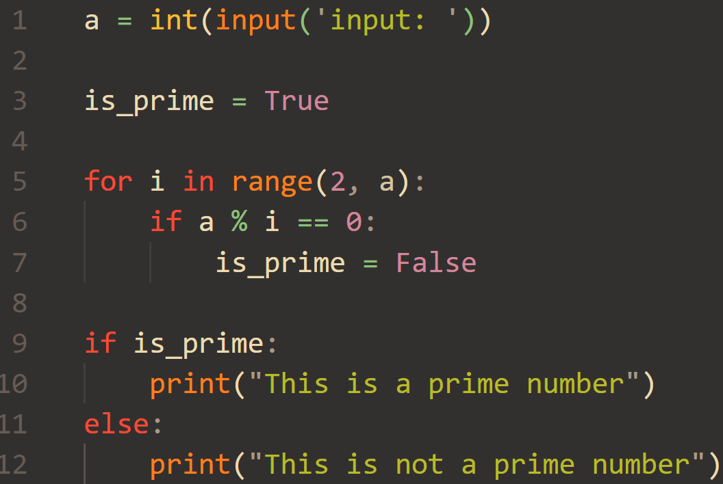
Answer

Slide 86
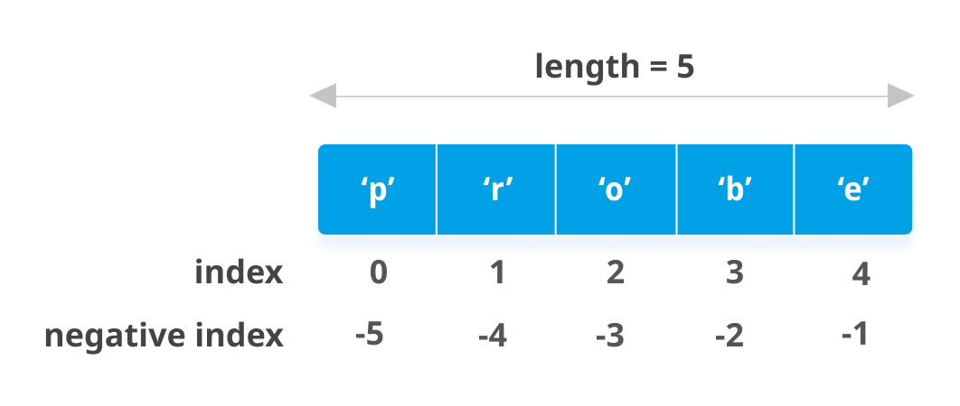
List
List is ordered collection, where you can store multiple values using one variable.
It allows duplicated items inside. The list below is 1-dimensional list.
element
list1 = ['p', 'r', 'o', 'b', 'e'] | makes a list that contains p, r, o, b, e as elements.

Slide 87
List
Get the values in a list by the index.
The first value’s index is 0, second is 1, third is 2, and so on.
If there is no value in the index, an error occurs.
This is called 'indexing'
print(list1[0]) print(list1[3]) print(list1[5]) | Prints the first value, which is 'p' Prints the fourth value, which is 'b' Occurs an error because there is no sixth value in the list.

Slide 88
List
You can get the number of elements in the list with len().
my_list = [1, 2, 3, 4, 5, 6, 7, 8] len(my_list) | Makes a list with 8 values Returns 8
list1 = ['p','r','o','b','e'] len(list1) | make a list with 5 values returns 5
my_list
 | 1 | 2 | 3 | 4 | 5 | 6 | 7 | 8
index | 0 | 1 | 2 | 3 | 4 | 5 | 6 | 7

Slide 89
List
You can get elements easily using for
list1=[14, 298, 40, 32, 7] for number in list1: print(number) | Iterate through list1 one by one. Each element is defined as number number is a variable name. You can change it to another name

Slide 90

List
We dealt with 1 dimensional list so far. Also, you can make a 2-dimensional list which looks like a table.
list2 = [[1,2,3], [4,5,6], [7,8,9]] | makes a 2-dimensional list

Slide 91
List
list2 = [ [1, 2, 3],
[4, 5, 6],
[7, 8, 9] ];
list2
[1,2,3] | [4,5,6] | [7,8,9]
list2[0]
1 | 2 | 3
list2[0][1]
1 | 2 | 3

Slide 92
List
You can also do indexing on 2-dimensional list. To do so, you need two information: row and column.
name_of_list[row][column]
print(list1[0][0]) print(list1[2][0]) print(list1[0][1]) | prints value at row 0 and column 0. prints value at row 2 and column 0. prints value at row 0 and column 1
NOTIFICATION
row and column also starts with 0.
That is, the first row number is 0 and the first column number is 0.

Slide 93
Lab
1.make a 1-dimensional list
2.print a, b, c by using index.
a | b | c
HINT
Index starts with 0. That is, 'a' is index 0, 'b' is index 1, and 'c' is index 2.

Slide 94

Answer

Slide 95
Lab
1.make a 1-dimensional list
2.print 1, 'a', and 'hello' by using index.
a | 1 | c | hello | 100.5
HINT
a, c, and hello are string type. 1 is integer type. 100.5 is float type.

Slide 96

Answer

Slide 97
Lab
1.make a 2-dimensional list
2.print a, b, h by using row and column
a | b | c
d | e | f
g | h | i
HINT
First row is 0 and first column is 0.
For example, at row 1 and column 1 is 'e'.

Slide 98

Answer

Slide 99
List
You can change the value of the list, which means lists are mutable.
You can replace or remove elements in the list, and also add elements to the list.
my_list = [1, 2, 3, 4, 5] my_list[3] = 100 my_list | Makes list Replaces the fourth value with 100 Returns [1, 2, 3, 100, 5]
my_list.append(6) my_list.append(7) my_list.append(8) my_list | Returns [1, 2, 3, 4, 5, 6, 7, 8]
my_list.remove(1) my_list | Removes the element with value 1 Returns [2, 3, 4, 5, 6, 7, 8]
my_list.pop(3) my_list | Removes the element with index 3 Returns [2, 3, 5, 6, 7, 8]

Slide 100


Lab
Make empty list.
Then receive 3 scores and take them in list as int.
Finally calculate average score.
input
output
HINT
To make an empty list, write: list1 = []

Slide 101

Answer

Slide 102
Bonus: list comprehension
Make list inline
[value for ~ in ~]
scores = [int(input) for _ in range(3)] (scores[0] + scores[1] + scores[2]) / 3

Slide 103


List
Make a program that receives the number of elements, receives positive values of elements, and print the maximum among them.
input
output
HINT
To receive n elements, write:
for i in range(n):
list1.append(int(input('input: '))

Slide 104

Answer

Slide 105


List
Make a program that receives the number of elements, receives positive values of elements, and print the minimum among them. ( input numbers are less than 1000 )
input
output
HINT
To receive n elements, write:
for i in range(n):
list1.append(int(input('input: '))

Slide 106

Answer

Slide 107

Function
Function is a block of code which is executed when it is called.
Function makes the code reusable
def f(x):
function_body
1
2
3
1: This is function name. Rules of function name is same with the rules of variable name.
2: This is called parameter. It's same with variable in math.
3: This is function body. It's the actual execution code in function f.

Slide 108

Function
def add(a, b): return a + b added_value = add(37, 42) another_added_value = add(21, 17) final_added_value = add(added_value, another_added_value) | Function header Function body Call function Call function Call function
Call add(37, 42) !!!
Call add(21, 17) !!!
computer:
Ok, I will give you
the result of 37+42
computer:
Ok, I will give you the result of 21+17
user
user

Slide 109
THANKS
Do you have any questions?
im.hongeun@gm.gist.ac.kr
hong_hyeokjae@gm.gist.ac.kr

